Slide 1

Note: The data and information in this document is reflective of a hypothetical situation and client. This document is to be used for KPMG Virtual Internship purposes only.
Sprocket Central Pty Ltd
Data analytics approach
Sarmast Bilawal Khuhro – Junior Analyst

Slide 2
Note: The data and information in this document is reflective of a hypothetical situation and client. This document is to be used for KPMG Virtual Internship purposes only.
Agenda
Introduction
Data Exploration
Model Development
Interpretation

Slide 3
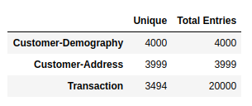
Note: The data and information in this document is reflective of a hypothetical situation and client. This document is to be used for KPMG Virtual Internship purposes only.
Introduction
Analysis of New Potential Customers
A brief look into following factors:
We will look at the old Customers Data
Do analysis of the important Features
Generate More Features
Create testing and Training Data
Model Generation
Model Application

Slide 4
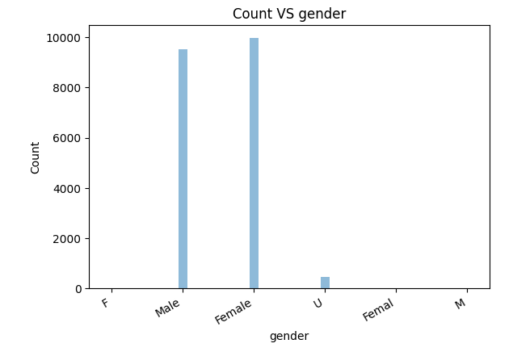
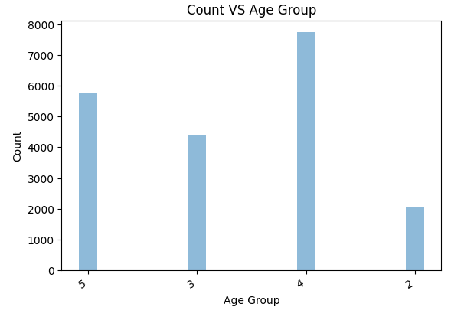
Note: The data and information in this document is reflective of a hypothetical situation and client. This document is to be used for KPMG Virtual Internship purposes only.
Data Exploration
Gender and Age Analysis
-Gender Ratio is Almost Neutral
-Female gender is dominates slightly
-Age Groups are divided as:
Class 2 = 16-25
Class 3 = 26-40
Class 4 = 40-55
Class 5 = Above 55
-From the Graph we can see our target customers are of age 40 and above.

Slide 5
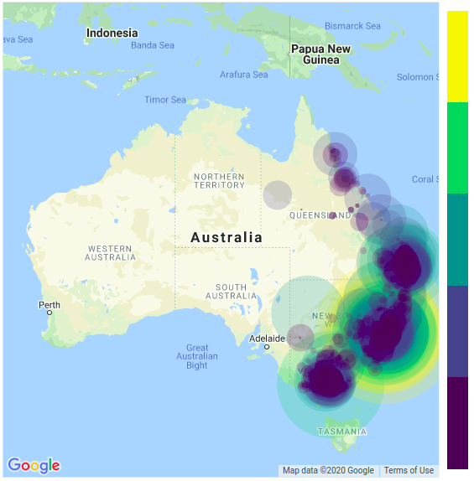
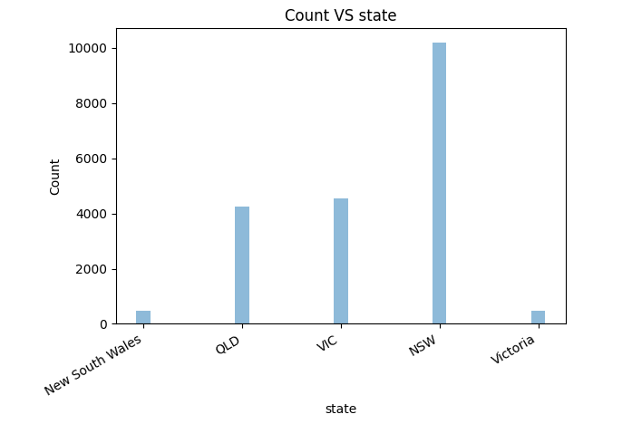
Note: The data and information in this document is reflective of a hypothetical situation and client. This document is to be used for KPMG Virtual Internship purposes only.
Data Exploration
Geolocation Heatmap
-This Heatmap shows the location of our frequent customers
Geo location was extracted from the postal code data
We can also see state comparison of our frequent Customers.
NSW seems to be a better customer base for the cycles

Slide 6
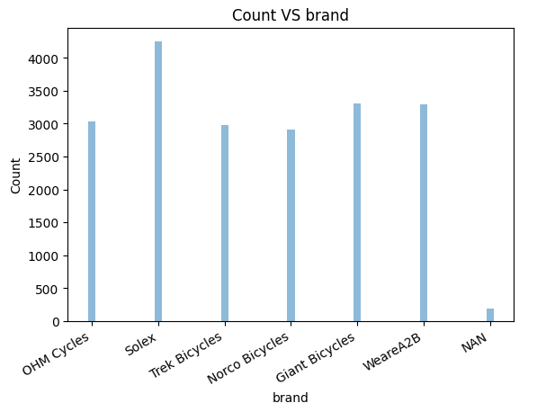
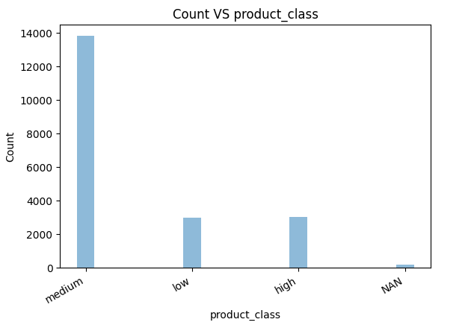
Note: The data and information in this document is reflective of a hypothetical situation and client. This document is to be used for KPMG Virtual Internship purposes only.
Model Development
Product Class Comparison
-Important Comparison between product class and brands.
-Medium class products are of higher customer choice.
-Solex brand dominates the most bought cycles. Thus These products advertisement should be increased.

Slide 7
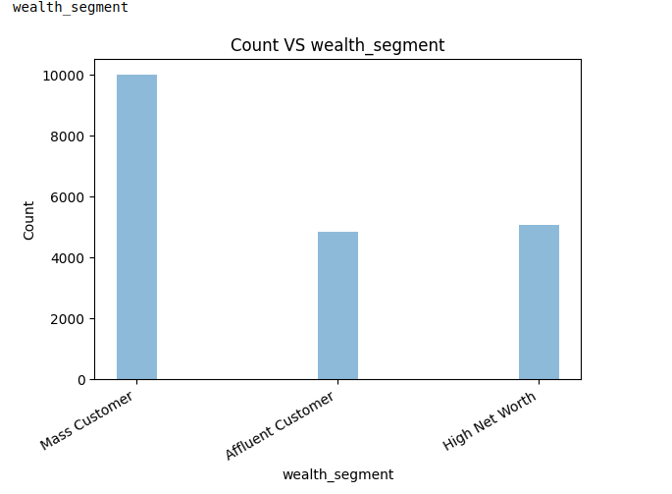
Note: The data and information in this document is reflective of a hypothetical situation and client. This document is to be used for KPMG Virtual Internship purposes only.
Interpretation
Wealth Segment Comparison
-Interesting comparison of our buyers
-Mass Customers dominate the purchase
-This class of buyers should be targeted more

Slide 8
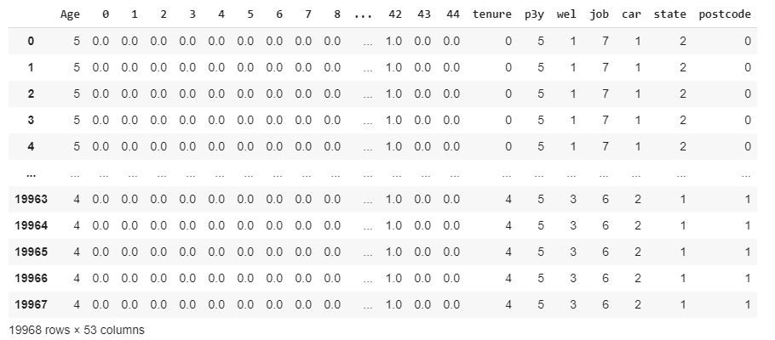
Note: The data and information in this document is reflective of a hypothetical situation and client. This document is to be used for KPMG Virtual Internship purposes only.
Interpretation
Feature Selection
Features Selected from the dataset:
Gender, Normalized to Female and Male
Age, categorized into 4 sections.
Job Title, hot encoded into all the options.
Tenure, Past 3 Years Purchase, Wealth Segment, Job Industry Category, Owns Car, State and Postcode. These features were selected because they also appeared in the new customer database. And These features were of importance. They were normalized and formed into a final dataset for training and testing split. Order Status was kept as the label for the training.

Slide 9
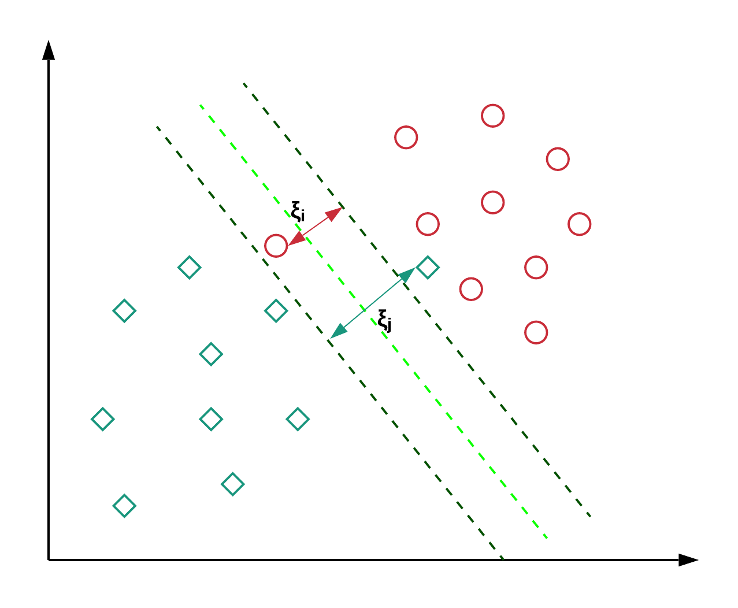
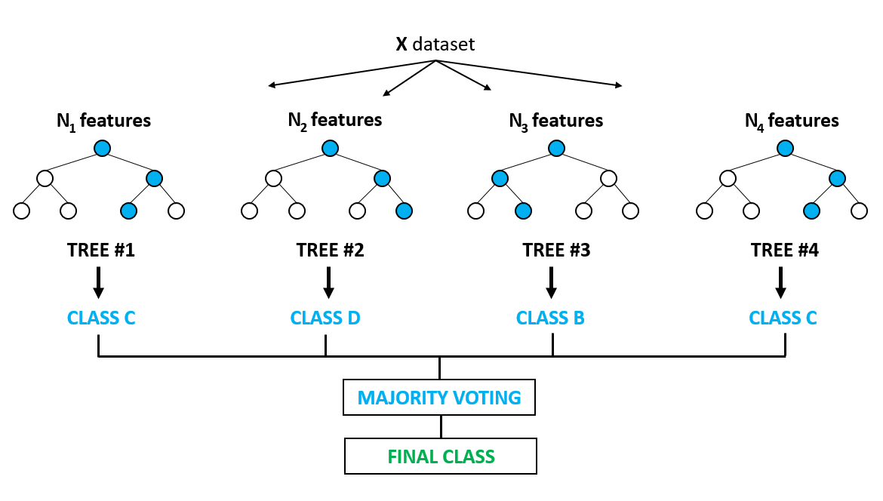
Note: The data and information in this document is reflective of a hypothetical situation and client. This document is to be used for KPMG Virtual Internship purposes only.
Interpretation
Model Selection
We will use two machine Learning models.
-SVM
-Random Forrest Classifiers
-Sklearn is used to normalize the data between 0 – 1
-Data is split into training and testing for the old customers dataset
-Once Data trained on old model same features are extracted from the new Model
-Prediction is done on the new Dataset to find out the chances of new customers making purchases.

Slide 10
Note: The data and information in this document is reflective of a hypothetical situation and client. This document is to be used for KPMG Virtual Internship purposes only.
Thank You

